Slide 1
FEC Lunch and Learn
Discovering Family Ownership
Discovering Family Ownership is specifically designed for current and future family business owners. Family Ownership has proven to be the pillar of family businesses around the world. However, understanding the roles each family member play in successful ownership, especially as a Next Gen, requires in-depth knowledge of what ownership means, how decision-making processes are made and mostly, how to approach different ownership models.
Notes:
TC

Slide 2
Overview of Course
Notes:
TC

Slide 3
Overview of Course
Notes:
TC

Slide 4
Introduction
Notes:
SL

Slide 5
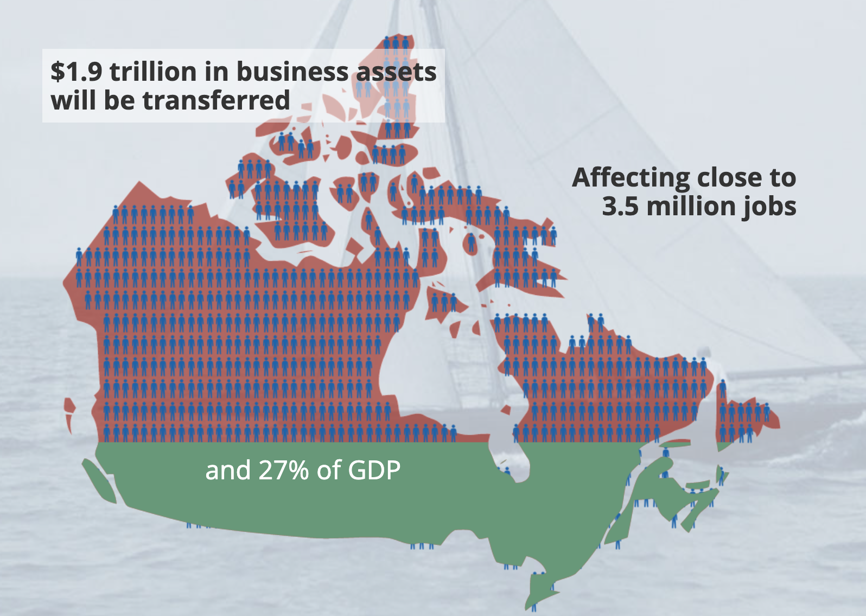
Introduction
Notes:
SL

Slide 6
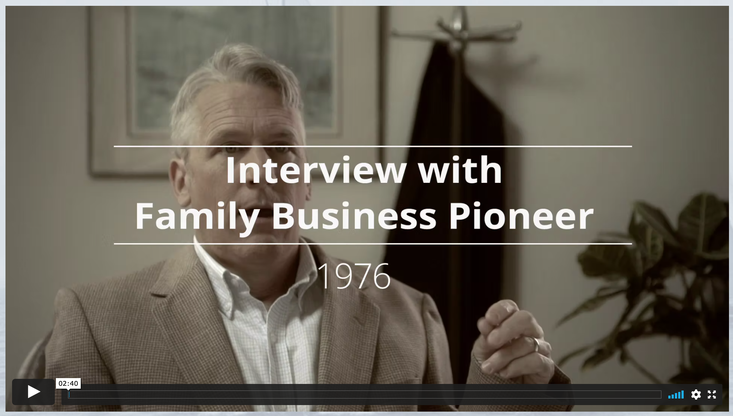
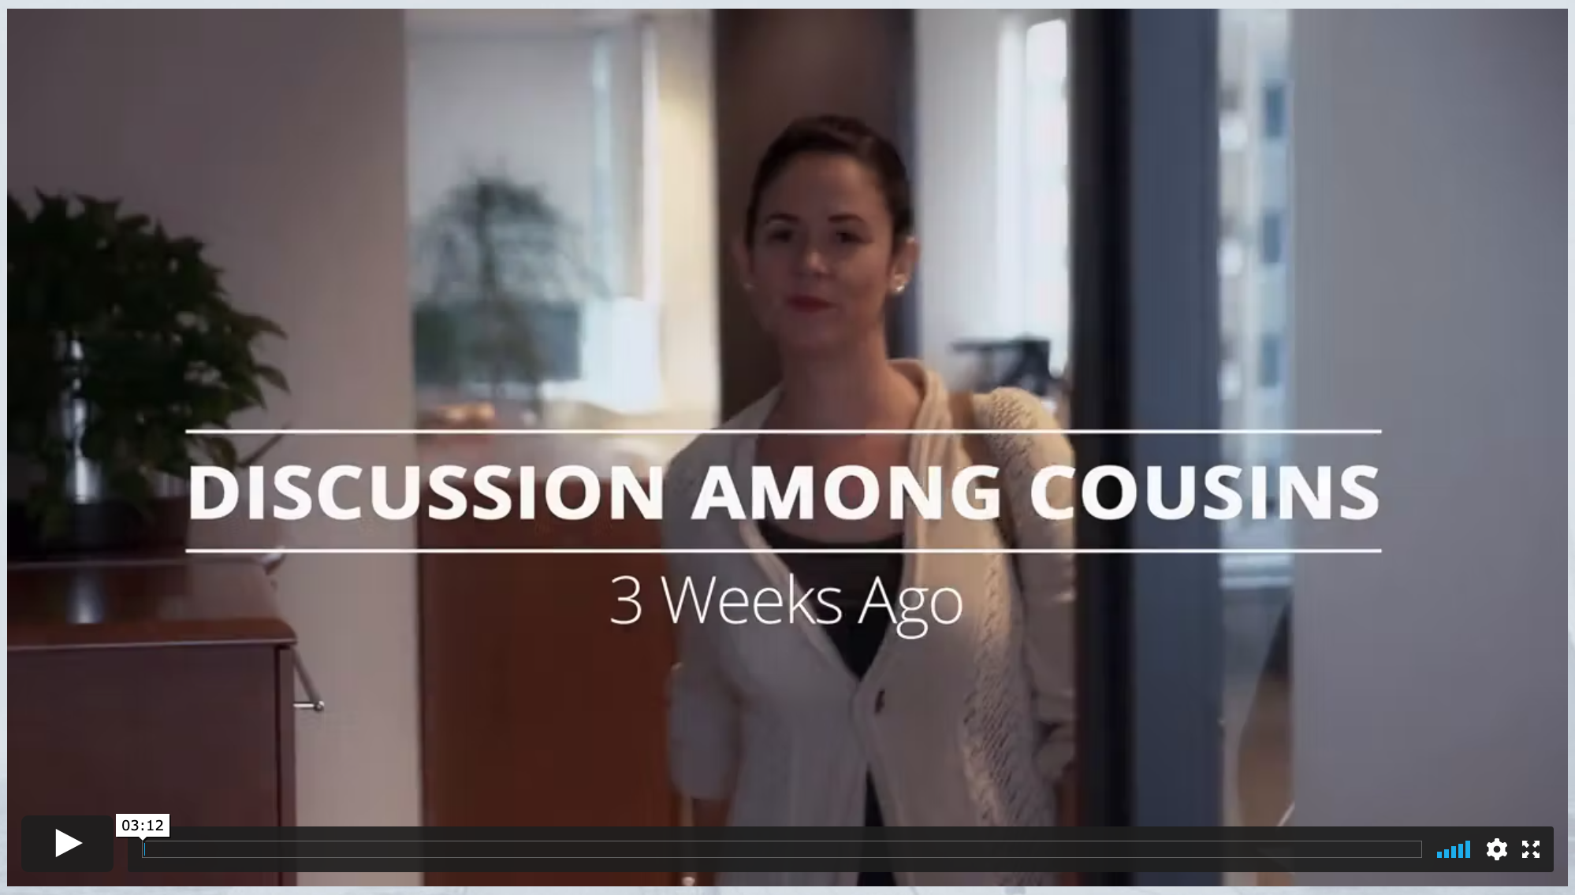
Unit 1 - Navigating Ownership
Notes:
TC

Slide 7
Unit 1 - Navigating Ownership
Notes:
TC

Slide 8
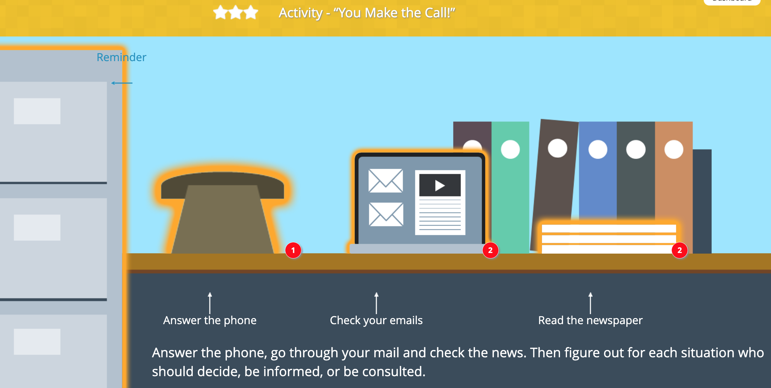
Unit 1 - Navigating Ownership
Notes:
TC

Slide 9
Unit 1 - Navigating Ownership
Facilitation Guide
Notes:
SL

Slide 10
Unit 2 - Roles and Responsibilities
Notes:
TC

Slide 11
Unit 2 - Roles and Responsibilities
Notes:
TC

Slide 12
Unit 2 - Roles and Responsibilities
Notes:
SL

Slide 13
Unit 2 - Roles and Responsibilities
Facilitation Guide
Notes:
SL

Slide 14
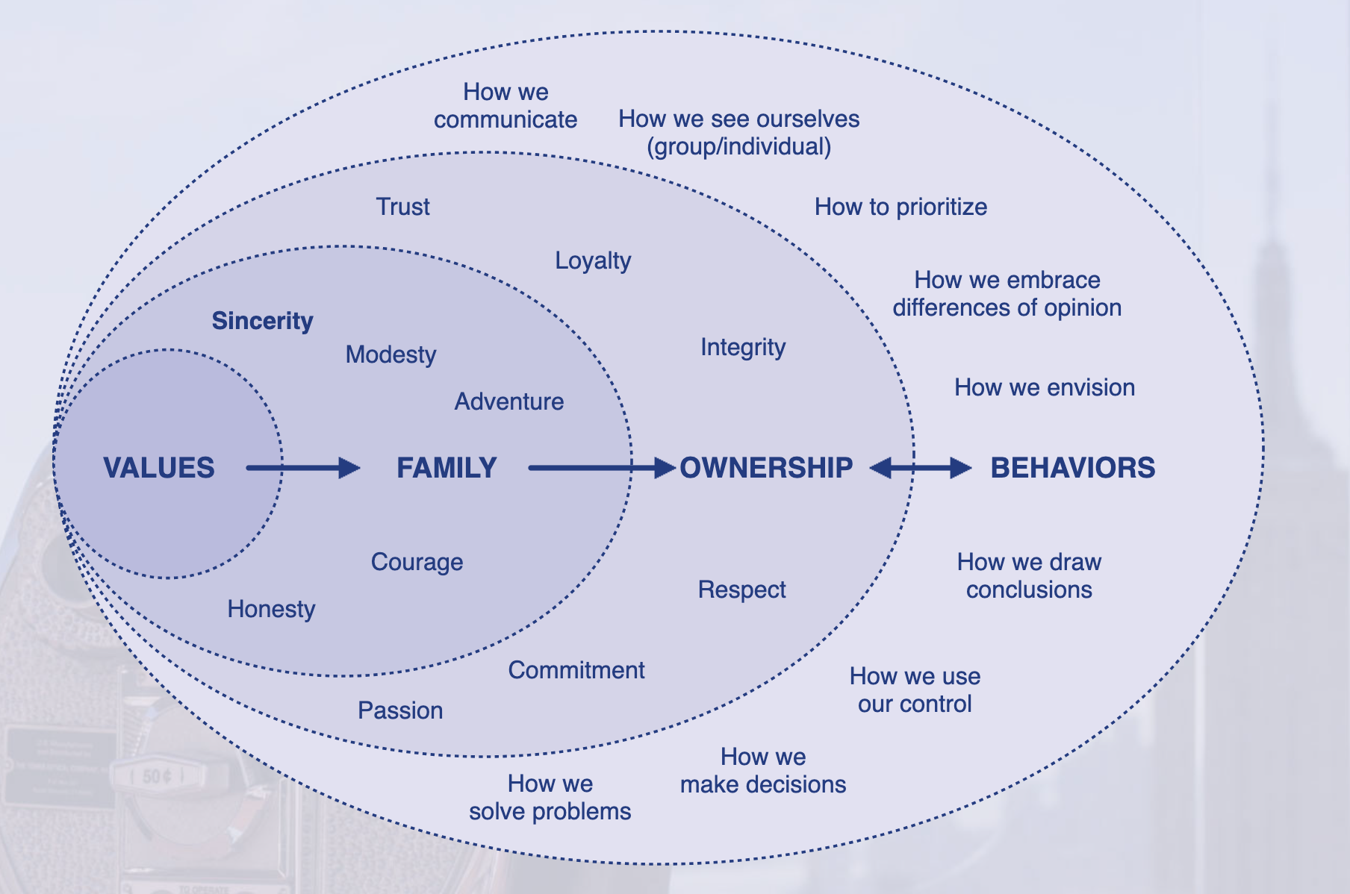
Unit 3 - Views and Values
Notes:
TC

Slide 15
Unit 3 - Views and Values
Notes:
TC

Slide 16
Unit 3 - Views and Values
Notes:
TC

Slide 17
Unit 3 - Views and Values
Facilitation Guide
Notes:
SL

Slide 18
Unit 4 - Succeeding in Succession
Notes:
SL

Slide 19
Unit 4 - Succeeding in Succession
Notes:
TC

Slide 20
Unit 4 - Succeeding in Succession
Notes:
TC

Slide 21
Unit 4 - Succeeding in Succession
Notes:
SL

Slide 22
Unit 4 - Succeeding in Succession
Notes:
TC

Slide 23
Discovering Family Ownership
Questions?

